Slide 1
Language translation model
Group 19
Team Members:
Divya Pamidi Sai Sasidhar Vemavarapu Harsha Vardhan Bitra

Slide 2
What’s Our Project About?
This project involves implementing advanced deep learning architectures, such as Transformers, to develop a system that can accurately and contextually translate text between different languages. It aims to leverage large datasets, handle complex linguistic nuances, and achieve better performance in automating the translation process.
Use of DL
They are generally used in language translation for their proficiency in understanding contextual variances, handling complex linguistic structures, and learning from extensive datasets. Their adaptability and efficiency in parallel processing make them superior to traditional rule-based methods, enabling accurate and scalable translations across multiple languages.

Slide 3
Dataset
The Europarl dataset is a collection of multilingual parallel texts that we've been using. It basically compiles translations of discussions held in the European Parliament, offering a diverse range of topics and languages.
Implemented Models
LSTM
GRU
GRU with Bahdanau Attention
GRU with Luong Attention
T5-based Model
Attention-based Transformer (Our Approach)

Slide 4
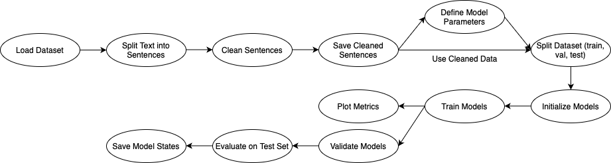
Process Flow

Slide 5
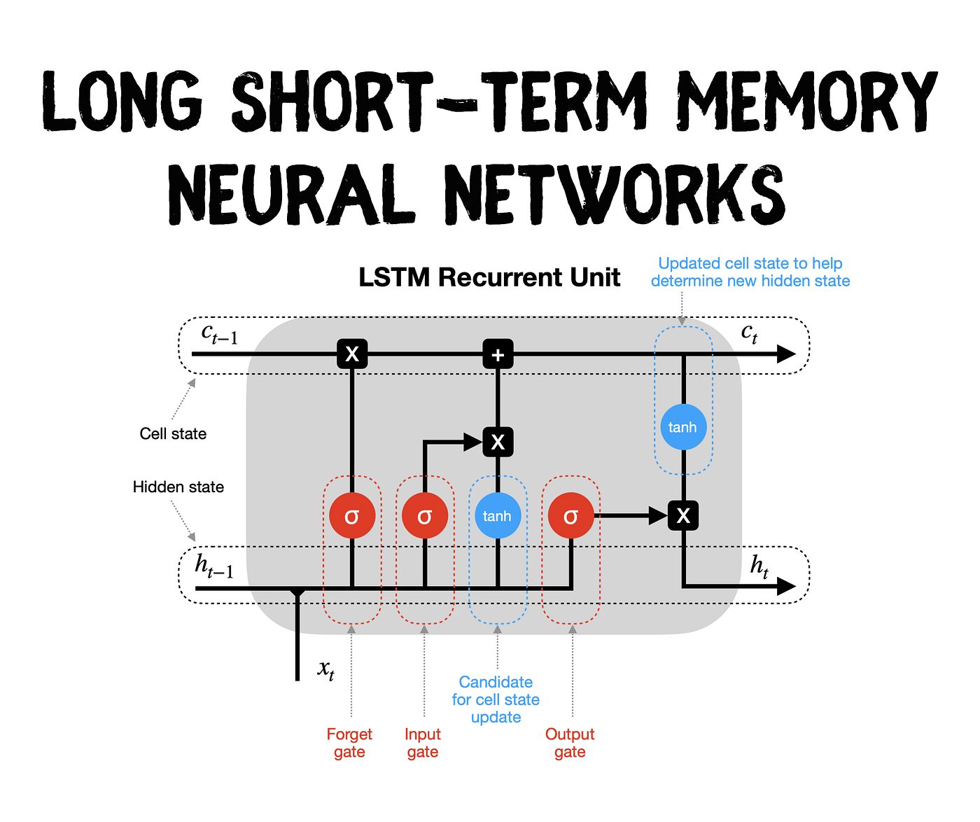
LSTM
It’s an advanced RNN architecture designed to overcome the vanishing gradient problem. Using memory cells and gates, LSTMs captures long-term dependencies, making them particularly effective for tasks in natural language processing and time-series analysis.

Slide 6
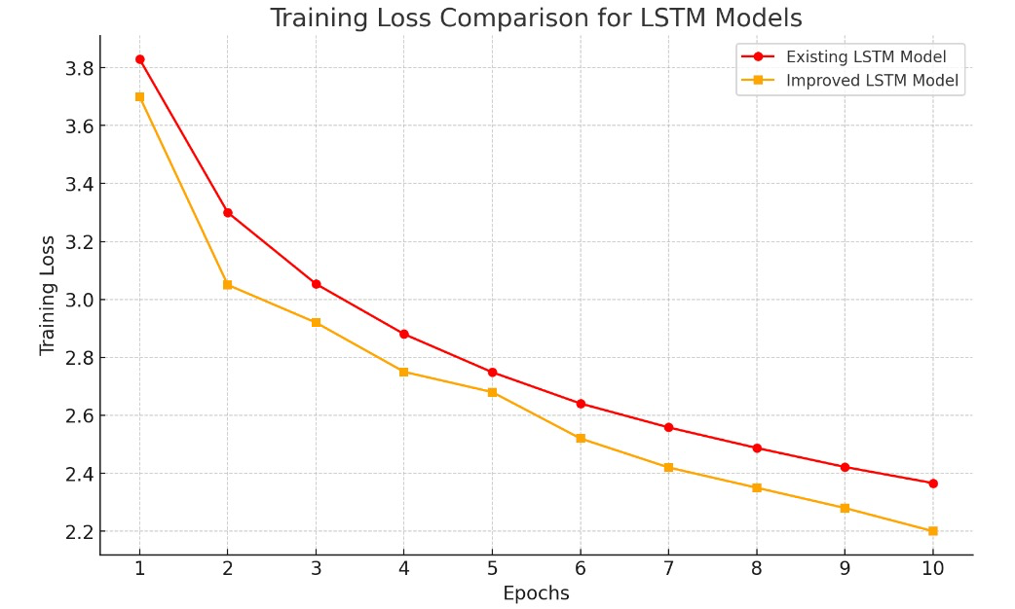
Result

Slide 7
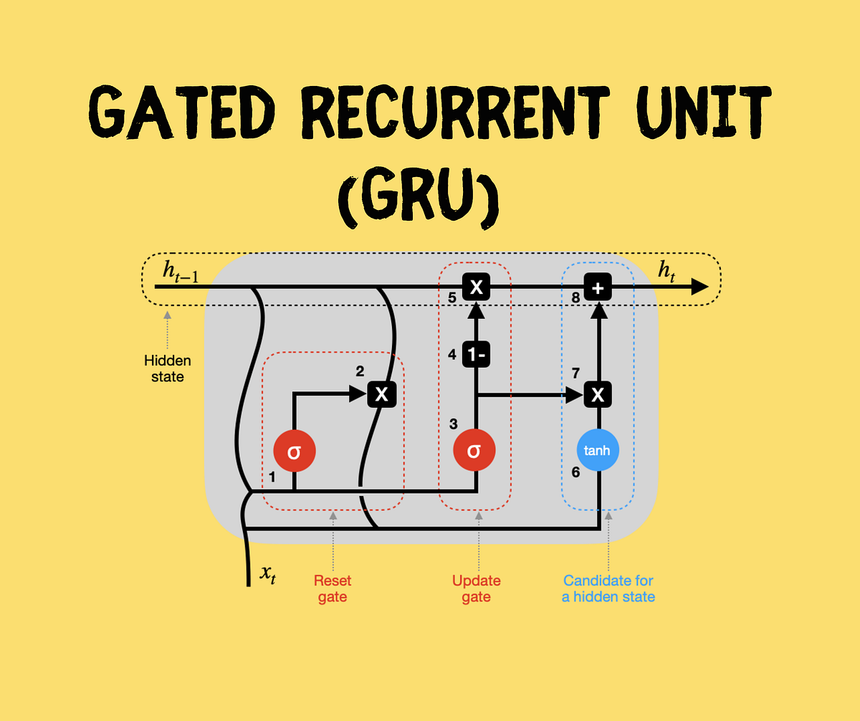
GRU
This model uses gating mechanisms to efficiently capture long-range dependencies in sequential data. It is a simplified version of the LSTM model, known for its effectiveness in language translation and text generation tasks

Slide 8
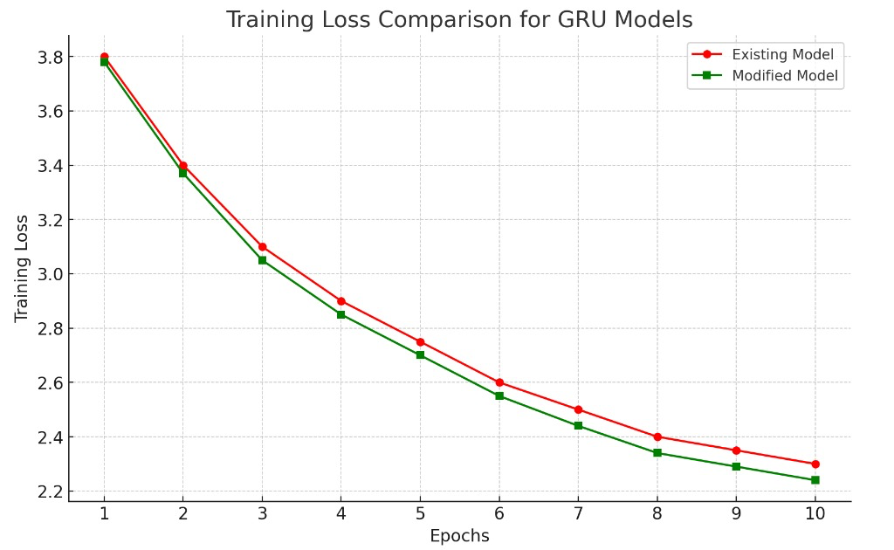
Result

Slide 9
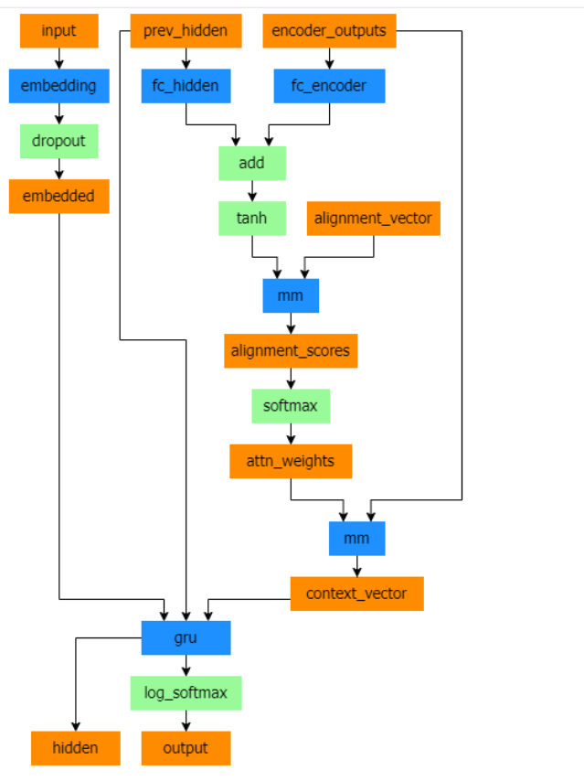
GRU with Bahdanau Attention
This model merges the GRU architecture with the Bahdanau attention mechanism, enhancing sequential dependency capture. This hybrid approach proves particularly effective in tasks like machine translation by incorporating attention to align and translate specific parts of input sequences.

Slide 10
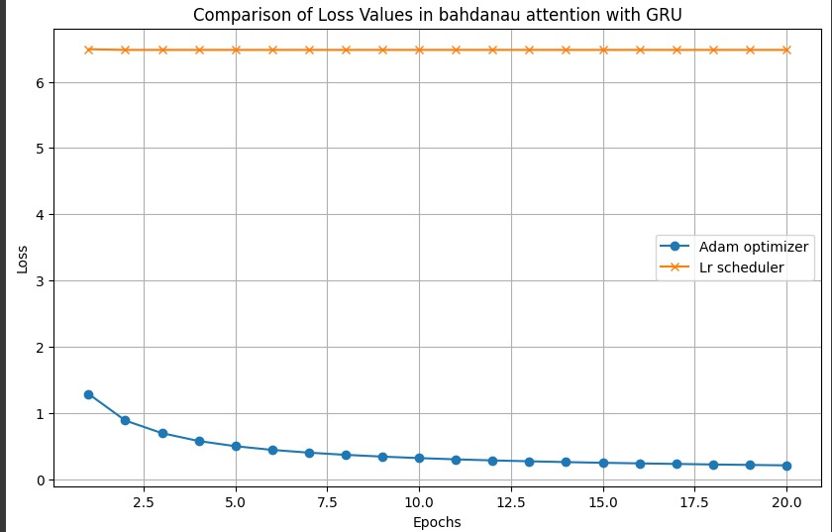
Result

Slide 11
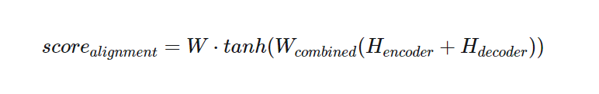
GRU with Luong Attention
This model merges the GRU architecture with the Luong attention mechanism, improving sequential dependency capture. This hybrid approach is especially effective in tasks like machine translation, leveraging attention to focus on relevant parts of input sequences during processing.

Slide 12
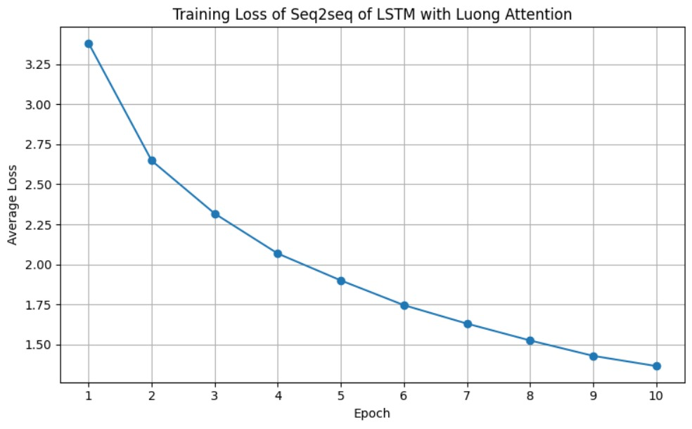
Result

Slide 13
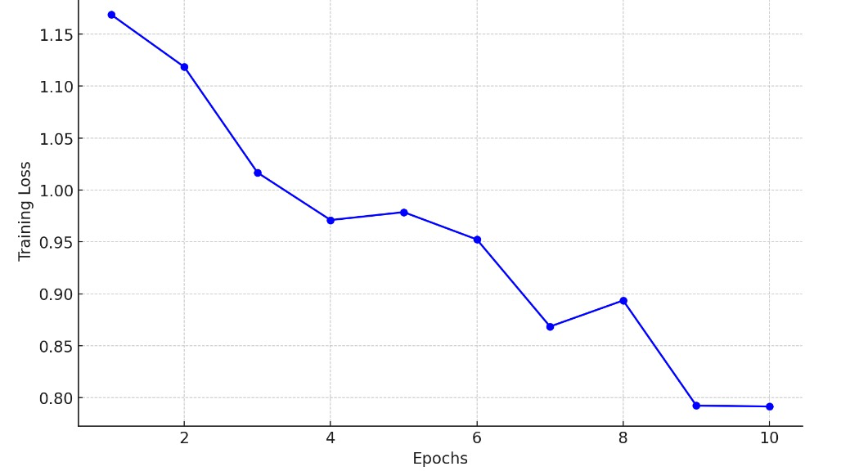
T5-based Model
This model refers to a model built upon the Transformer architecture known as T5 (Text-to-Text Transfer Transformer). This treats all NLP tasks as a text-to-text problem, unifying various language tasks like translation, summarization, and question-answering under a single framework. It achieves better results by pre-training on a large corpus and fine-tuning for specific tasks, demonstrating high performance across a wide range of NLP tasks.

Slide 14
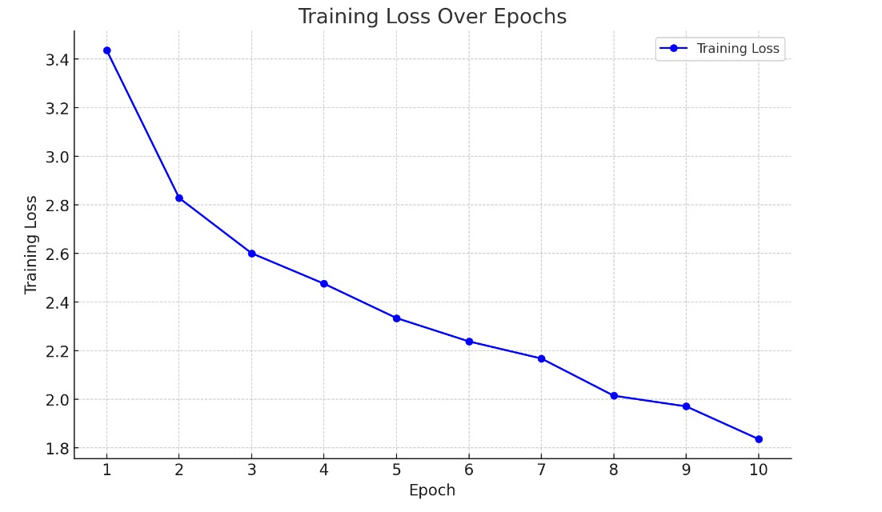
Attention-based Transformer (Our Model)
Model Architecture
Implemented a Multi-Head Attention Layer.
Inclusion of Transformer components like Positional Encoding, Feed-Forward Layers, and Normalization.

Slide 15
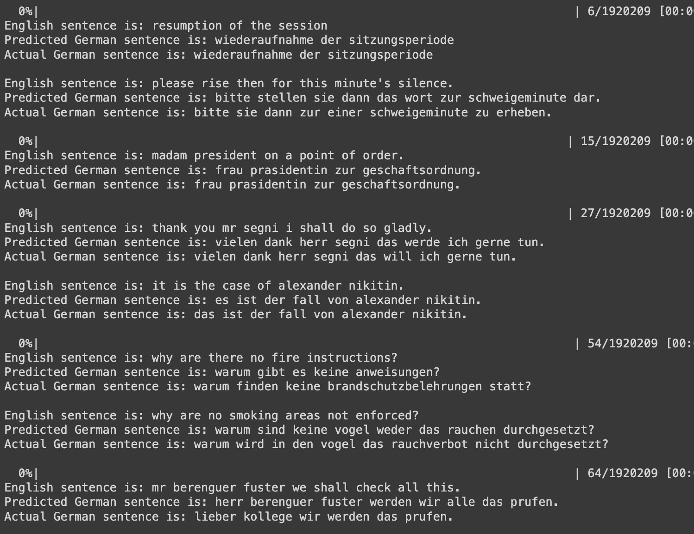
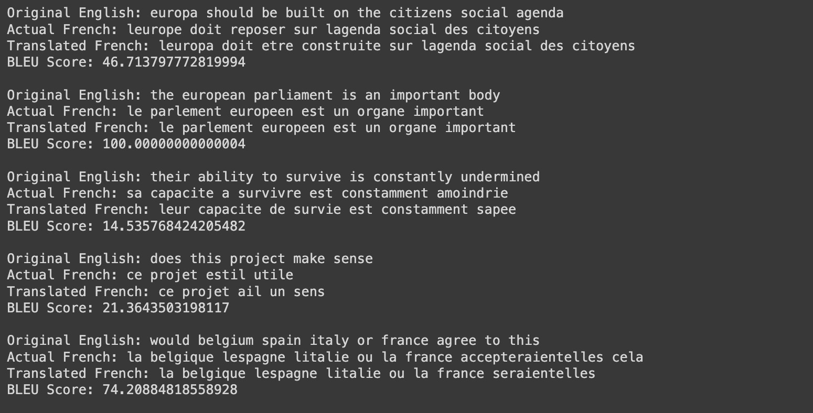
Result
English to German | English to French

Slide 16
Test Data Loss
Models | Test Loss
LSTM | 3.191
GRU | 3.073
T5-based Model | 1.035
Our Approach | 2.389

Slide 17
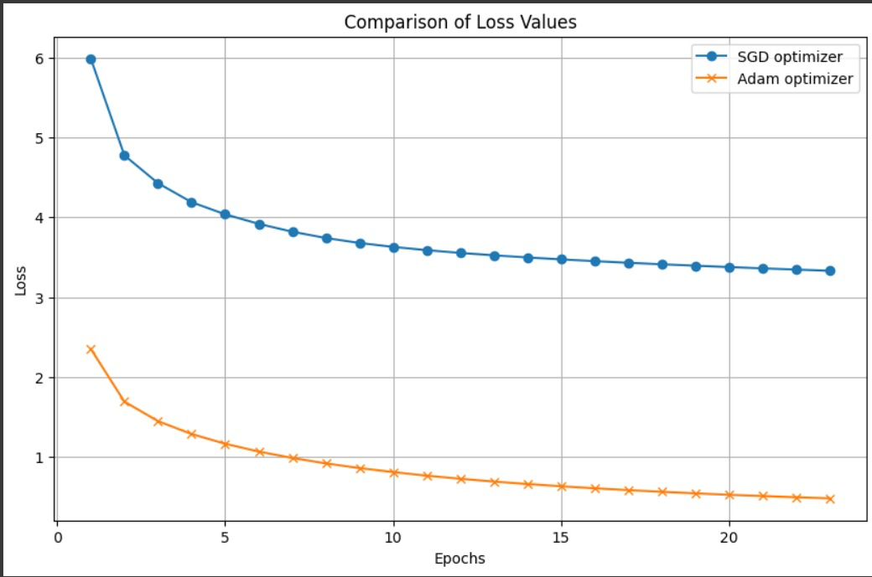
Appendix

Slide 18
References
https://arxiv.org/abs/1706.03762
https://pytorch.org/tutorials/
https://arxiv.org/abs/1508.04025

Slide 19
Thank You 🙏🏻

